Slide 1
Microsoft Dynamics 365 Developer Training - Part 2
Satish Reddy

Slide 2
Client-side Components
JavaScript
HTML
CSS
Web API
Ribbon

Slide 3
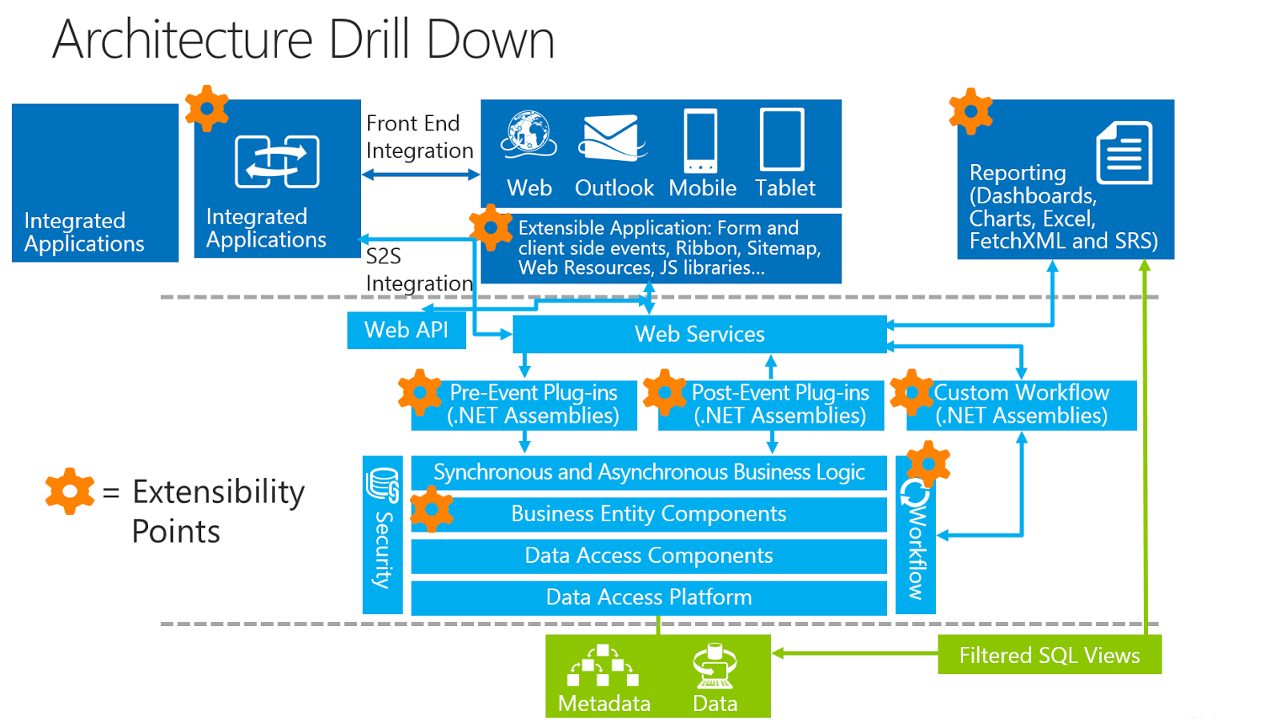
Image credit: http://jopx.blogspot.com/2016/04/software-boundaries-and-limits-for.html

Slide 4
Common Scenarios
Validations
Custom UI
Show and hide user interface elements.
Interact with the business process flow control.

Slide 5
Client-side Events
Form OnLoad
Form OnSave
Attribute OnChange
Lookup PreSearch
Grid Events
OnRecordSelect
OnSave
OnChange
6. Business Process Events etc.
Event Handler
Contact.js
Events
function HelloWorld()
{
}

Slide 6
Client API provides methods and objects to apply custom business logic using JavaScript.

Slide 7
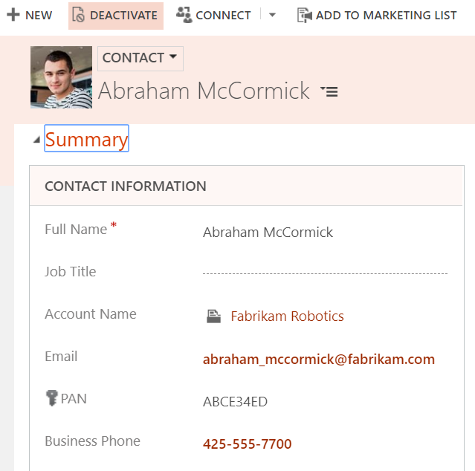
function HelloWorld()
{
}
Client API

Slide 8

Client API Objects At Root
executionContext
formContext
gridContext
Xrm Object

Slide 9
A file for common functions
Entity Specific files
GlobalHelper.js
AccountScripts.js
ContactScripts.js

Slide 10
Getting formContext
function DisplayHelloWorld(executionContext) { var formContext = executionContext.getFormContext();
}

Slide 11
formContext
Data object
formContext.data.entity.attributes
UI object
formContext.ui.controls

Slide 12
Data Object (attributes)
function DisplayHelloWorld(executionContext) { var formContext = executionContext.getFormContext();
var firstName =
formContext.data.entity.attributes.get(“firstname”).getValue();
// Or Use Shortcut
var firstName = formContext.getAttribute("firstname").getValue(); }

Slide 13
Form Notification
Field Notification
formContext.ui.setFormNotification(message, level, uniqueid)
formContext.getControl(“attribute”).setNotification(message, uniqueId);

Slide 14
Setting attribute data
Set attribute value through JavaScript
formContext.getAttribute(“logicalname”).setValue(“text”)

Slide 15
Auto Save
Dynamics 365 automatically saves the form if something is changed on the form.
It is enabled by default. You can disable it. (This option is at System level, applies for all entities)
But, you cannot enable or disable for specific entities.

Slide 16
Getting formContext
function DisplayHelloWorld(executionContext) { var formContext = executionContext.getFormContext();
var firstName =
formContext.data.entity.attributes.get(“firstname”).getValue();
var firstName = formContext.getAttribute("firstname").getValue(); }

Slide 17
Namespace Notation
var Sdk = window.Sdk || {}; (function () { // Code to run in the form OnLoad event this.formOnLoad = function (executionContext)
{
}
this.formOnSave = function (executionContext)
{
}
}).call(Sdk);

Slide 18
Preventing AutoSave for specific entity
function preventAutoSave(executionContext) {
var eventArgs = executionContext.getEventArgs();
if (eventArgs.getSaveMode() == 70) {
eventArgs.preventDefault();
}
}
Notes:
https://docs.microsoft.com/en-us/dynamics365/customer-engagement/developer/clientapi/reference/save-event-arguments/getsavemode

Slide 19
formType
function SomeFunction(executionContext) {
var formContext = executionContext.getFormContext();
var formtype= formContext.ui.getFormType();
if (formtype == 1) {
// Runs when user is creating a record
}else if (formtype == 2) {
// Runs when user opens the existing record
}
}
Notes:
https://docs.microsoft.com/en-us/dynamics365/customer-engagement/developer/clientapi/reference/save-event-arguments/getsavemode

Slide 20
Reading data from Lookups
Notes:
https://docs.microsoft.com/en-us/dynamics365/customer-engagement/developer/clientapi/reference/save-event-arguments/getsavemode

Slide 21
Showing Notifications
formContext.ui.setFormNotification(message, level, uniqueId);
Notes:
https://docs.microsoft.com/en-us/dynamics365/customer-engagement/developer/clientapi/reference/save-event-arguments/getsavemode

Slide 23
Demo:
If Contact’s Shipping method is FedEx, Freight terms attribute should be disabled.

Slide 24
Demo (Hello World)
Goals:
Creating JavaScript Web resource file.
Event Handler: Tagging Events to JavaScript functions
Understanding basic client-side events.

Slide 25

Business Requirement:
Phone numbers should be in US phone number format.

Slide 26
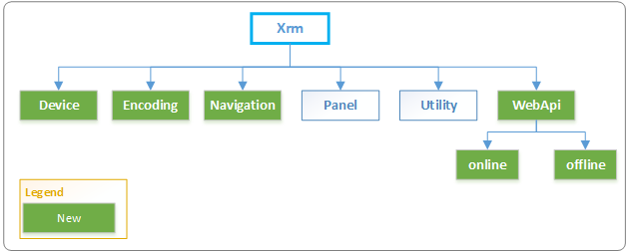
Xrm Object

Slide 27
formContext.ui.getFormType()
1 | Create Form
2 | Update Form
3 | Read-only Form
4 | Disabled

Slide 28
Prior to 9.x version
Xrm.Page.getAttribute(“”).getValue();
In the latest version
formContext.getAttribute(“”).getValue();

Slide 29
HTML Web Resource:
Popular web resource type apart from JS web resource
To design custom UI (Eg: buttons, modern HTML5 controls)
To display web content
You can refer CSS files, other JS files. (local or remote)

Slide 30
Accessing form elements in HTML Web Resource: (Use old code “Xrm.Page” not formContext)
Example: Reading form data in HTML
parent.Xrm.Page.getAttrubute(“attributename”).getValue()

Slide 31
Referring other web resources from HTML
Example:
<script src="script.js" type="text/javascript"></script>
<link href="style.css" rel="stylesheet" type="text/css" />

Slide 32
To access Organization Webservice from client script, Use Web API
Offline Web API
Online Web API

Slide 33
Offline WEB API (Xrm.WebApi.offline)
Provides methods to create and manage records in mobile clients while working in the offline mode.

Slide 34
Online WEB API (Xrm.WebApi.online)
createRecord
deleteRecord
retrieveRecord
retrieveMultipleRecords
updateRecord
execute
executeMultiple

Slide 35
Functions and Actions in WEB API
execute
executeMultiple

Slide 36
Web API
Web API implements the OData (Open Data Protocol)
RESTful API
Representational State
Transfer
Simple, Faster and more
Secure
Error Handling

Slide 37
So far we discussed, WEB API with Dynamics 365 Web Resources.
Any other scenarios where you can use Web API?

Slide 38
Web API during Integrations
.Net Applications
SDK Assemblies can be used or Web API can be used
Other Technologies
You can directly use Web API

Slide 39
Demo: Showing contact’s location on Google Map
Create API key for Google Maps
Get sample code google to create new HTML web resource.
Use latitude and longitude attributes of contact.

